Slide 1
Data Structures-2

Slide 2
Set:
Set is a collection which is unordered and unindexed.
It does not allows duplicate members.
A set itself may be modified(mutable), but the elements contained in the set must be of an immutable type.
Sets can be used to perform mathematical set operations like union, intersection, symmetric difference etc.

Slide 3
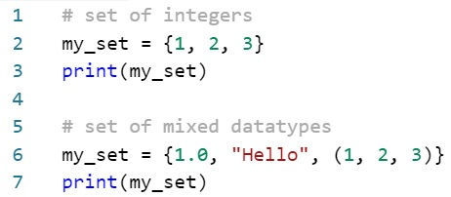
Creating set:
A set is created by placing all the items (elements) inside curly braces { }, separated by comma or by using the built-in function set().
It can have any number of items and they may be of different types( integer, float, tuple, string etc.).
But a set cannot have a mutable element, like list.

Slide 4
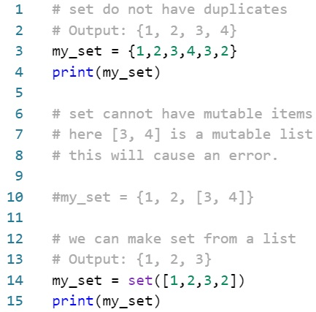
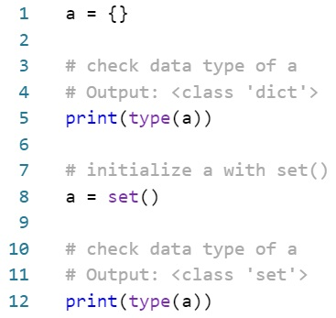
Creating an empty set is a bit tricky.
Empty curly braces {} will make an empty dictionary in Python.
To make a set without any elements we use the set() function without any argument.

Slide 5
Changing a set:
Sets are mutable. But since they are unordered, indexing have no meaning.
We cannot access or change an element of set using indexing or slicing. Set does not support it.
We can add single element using the add() method and multiple elements using the update method.
The update() method can take tuples, lists, strings or other sets as its argument.
In all cases, duplicates are avoided.

Slide 6
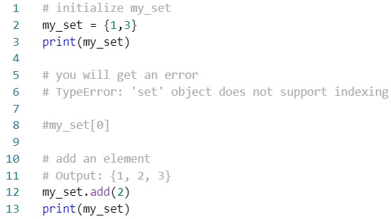
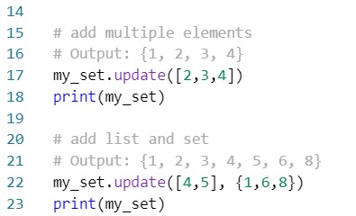
Code:

Slide 7
Removing elements:
A particular item can be removed from set using methods, discard() and remove()
The only difference between the two is that while using discard() if the item does not exist in the set, it remains unchanged.
But remove() will raise an error in such condition.

Slide 8
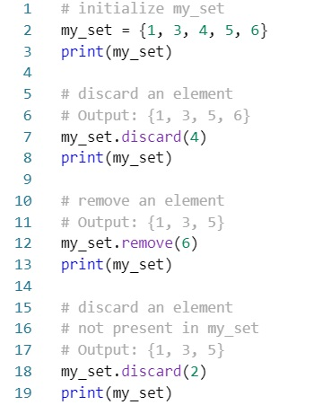
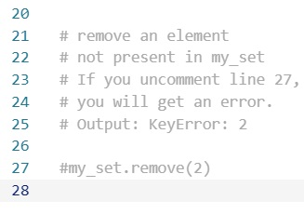

Example:

Slide 9
Similarly, we can remove and return an item using the pop() method.
Set being unordered, there is no way of determining which item will be popped. It is completely arbitrary.
We can also remove all items from a set using clear() method.
Keyword del is used to delete the set completely.

Slide 10
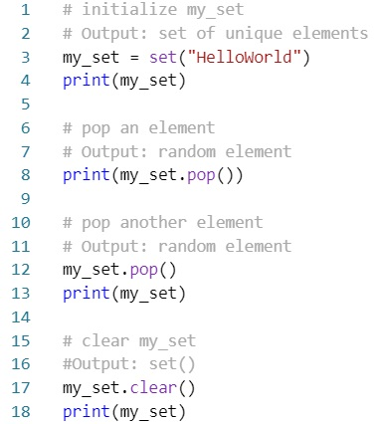
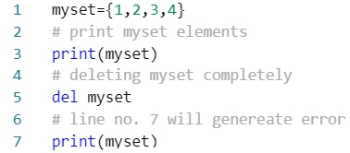
Example:

Slide 11
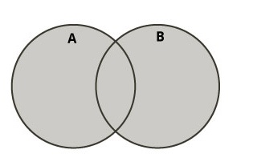
Set operation:
Sets can be used to carry out mathematical set operations like union, intersection, difference and symmetric difference.
We can do this with operators or methods.
Set Union:
Union of A and B is a set of all elements from both sets.
Union is performed using | operator.
Same can be accomplished using the method union().

Slide 12
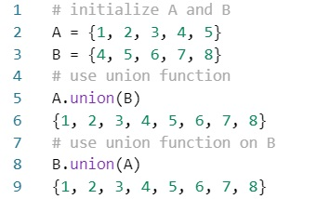
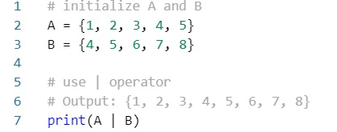
Example : set union
Using operator:
Using method:

Slide 13
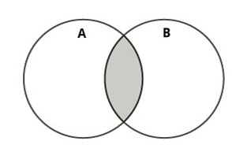
Set intersection:
Intersection of A and B is a set of elements that are common in both sets.
Intersection is performed using & operator.
Same can be accomplished using the method intersection().

Slide 14
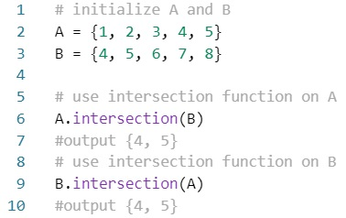
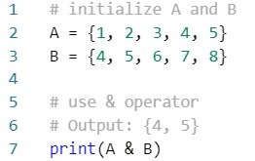
Example : set intersection
Using operator:
Using method:

Slide 15
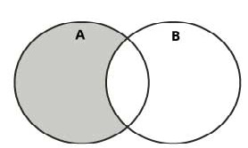
Set Difference:
Difference if A and B (A - B) is a set of elements that are only in A but not in B.
Similarly, B – A is a set of element in B but not in A.
Difference is performed using – operator.
Same can be accomplished using the method difference().

Slide 16
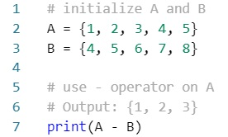
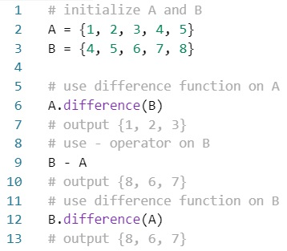
Example: set difference
Using Operator:
Using method:

Slide 17
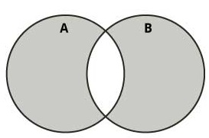
Set symmetric Difference:
Symmetric difference of A and B is a set of elements in both A and B except those that are common in both.
Symmetric difference is performed using ^ operator.
Same can be accomplished using method symmetric_difference().

Slide 18
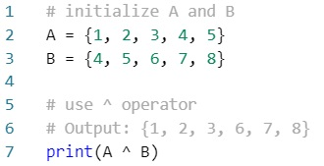
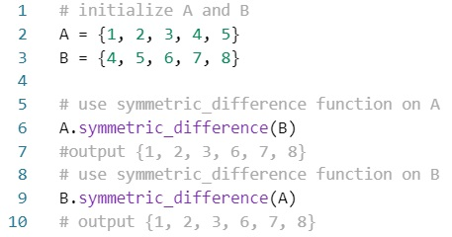
Example : symmetric difference
Using operator:
Using method:

Slide 19
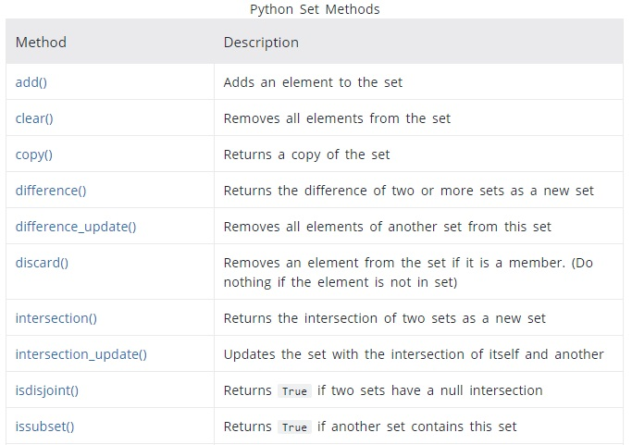
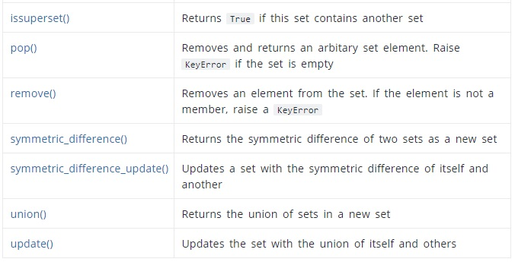
Set Methods:

Slide 20
**End**

